Slide 1












CSE 474
AN ALGORITHMIC APPROACH FOR OPTIMIZING CYCLONE EVACUATION PROCESSES USING AGENT-BASED SIMULATION
TAMANNA SULTANA TONU (ID: 19101155)
HUMAIRA RAHMAN OISHI (ID: 19101391)
SHOWRIN RAHMAN (ID: 21301033)
MD. TANVIR JAWAD (ID: 21101221)
GROUP 7

Slide 2





contents
1.
Introduciton
2.
Previous Work
3.
Literature Review
4.
Collected Data
5.
Proposed Methodology
6.
Simulator and Algorithm
7.
Conclusion

Slide 3
Introduction
Begin with a compelling overview of the need for an optimal cyclone evacuation algorithm, emphasizing the importance of disaster preparedness.
1. Innovative Approach: A multi-agent cyclone evacuation simulation framework for overcoming challenges.
2. Efficient Pathfinding: Utilizes the A* pathfinding algorithm for unpredictable movement of cyclones and changing shelter capacities.
3. Comprehensive Realism: Incorporating critical factors like population density, shelter location, and capacity.
4. Practical Tool for Planning: Tool for emergency planners and architects, enabling them to test and refine evacuation.
5. Significant Implications: Significant implications for disaster preparedness, architectural design, and public safety strategies in cyclone-prone areas.

Slide 4
Previous Works
1. Limited Generalizability: Might not provide a unified framework applicable to all evacuation scenarios.
2. Limited Consideration of Human Factors: Some models may still adequately address the complexities of human decision-making during evacuations.
3. Simulation Realism: Chances of facing challenges in accurately capturing the complex and dynamic nature of human behavior during evacuations. The realism of simulations heavily relies on the assumptions and parameters set by the modelers.

Slide 5


Literature Review
Exploring existing research on cyclone evacuation methods, highlighting gaps or shortcomings in current approaches and identifying key insights has guided our proposed methodology.
The core of the proposed evacuation simulation framework is the A* pathfinding algorithm. Literature on A* pathfinding demonstrates its efficiency in navigating complex environments. Our approach incorporates real-time meteorological data to dynamically adjust evacuation routes, ensuring the most efficient paths are taken. Additionally, the algorithm leverages advanced communication technologies to enhance coordination and dissemination of critical information during evacuations.

Slide 6
Collected Data
Present the data sources you've gathered, emphasizing the relevance and reliability of the information. Discuss any challenges encountered during data collection.
Accurate and up-to-date information is the backbone of effective evacuation planning. For our algorithm, we've relied on a multitude of data sources, including meteorological and geographical data. These sources provide essential insights into the cyclone's path, intensity, and affected areas. We understand that timely and precise information is crucial for making informed decisions during evacuation planning, and our algorithm ensures that by utilizing the most reliable data available.

Slide 7

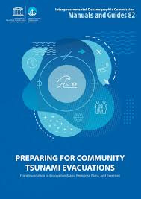

important data
Cyclone Tracks and Intensities:
Source: nhc.noaa.gov
Cyclone-Induced Storm Surge:
Source: earthdata.nasa.gov
Population Density and Distribution:
Source: earthdata.nasa.gov
Cyclone Evacuation Simulation Model (AnyLogic):
Source: nhc.noaa.gov
Cyclone Evacuation Simulation Model (NetLogo):
Source: link.springer.com
Humanitarian Data Exchange - Cyclone Data:
Source: data.humdata.org
Scientific Research Article - Vulnerability to Cyclonic Coastal Flooding:
Source: link.springer.com
World Bank Blog - Data Sharing for Disaster Resilience:
Source: worldbank.org

Slide 8

Proposed Methodology
1. Grid-based Simulation Environment
2. Individual Agent Modeling
3. Integral A* Pathfinding Algorithm
4. Probabilistic Cyclone Path Simulation
5. Strategic Shelter Capacity Management

Slide 9
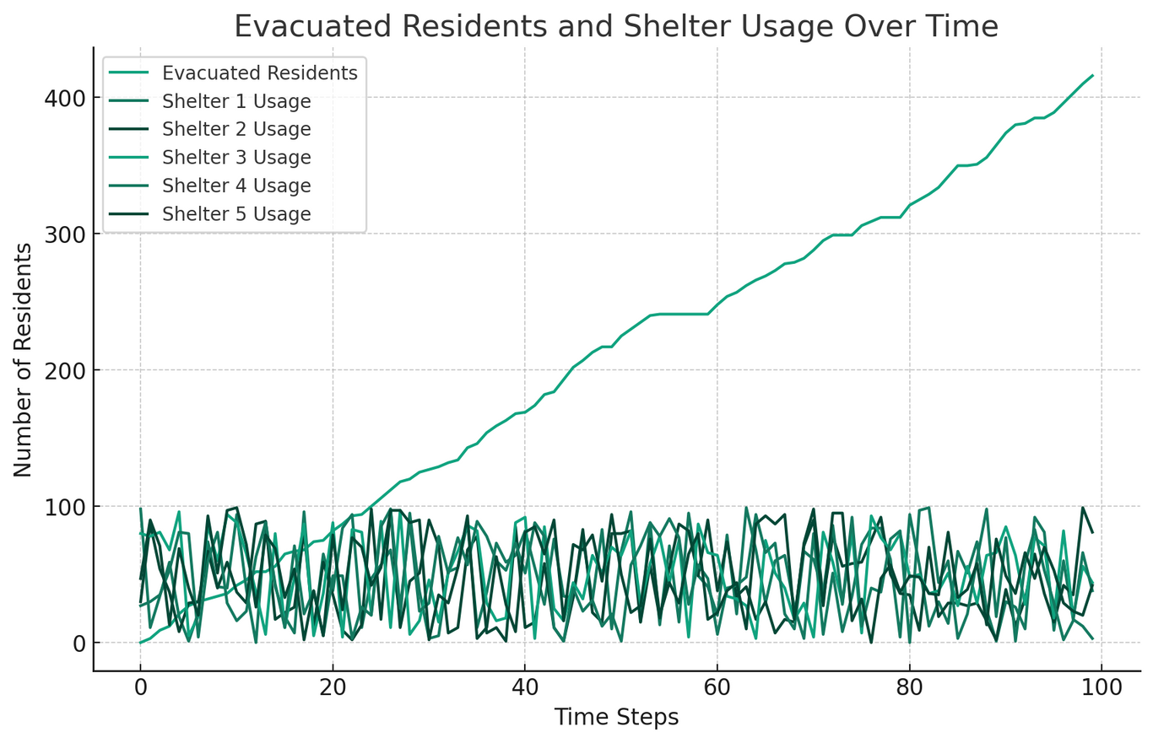
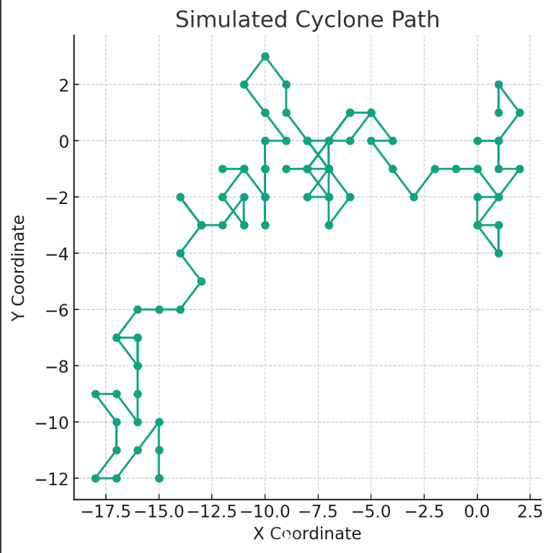

Slide 10
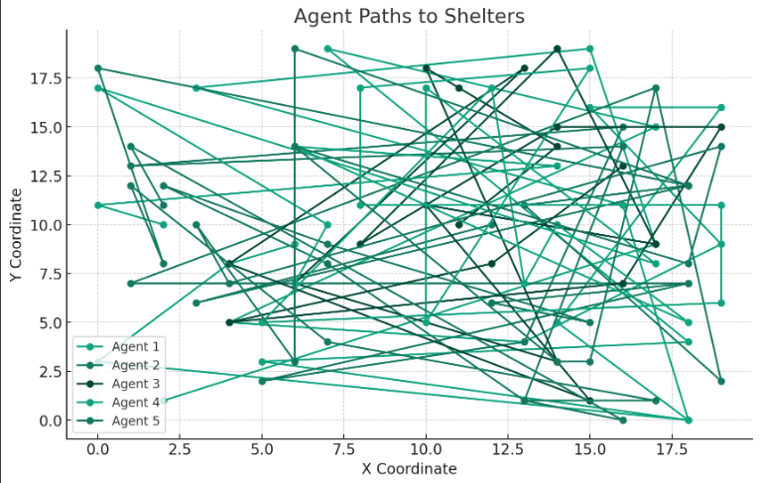


Slide 11

Conclusion
The optimal cyclone evacuation algorithm presented in our research demonstrates a significant advancement in disaster preparedness. By integrating real-time meteorological data, dynamic risk assessment, and optimization algorithms, the proposed methodology offers a comprehensive solution for efficient evacuation planning.
The incorporation of advanced technologies and continuous refinement mechanisms contributes to adaptability in the face of evolving conditions.
Overall, our study underscores the critical importance of proactive measures in safeguarding vulnerable communities during cyclonic events.
Thank you.

